Slide 1
LSTM (Detailed)
Marlabs

Slide 2
Table of Content
The Vanilla LSTM
The Stacked LSTM
The CNN LSTM
The Encoder-Decoder LSTMs
The Generative LSTMs

Slide 3
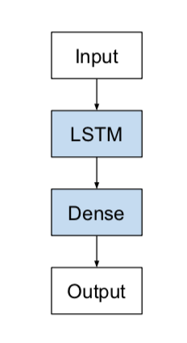
The Vanilla LSTM
A simple LSTM configuration is the Vanilla LSTM.
The Vanilla LSTM is defined as:
Input layer
Fully connected LSTM hidden layer
Fully connected output layer
Properties:
Sequence classification conditional on multiple distributed input time steps.
Memory of precise input observations over thousands of time steps.
Sequence prediction as a function of prior time steps.
Robust to the insertion of random time steps on the input sequence.
Robust to the placement of signal data on the input sequence.

Slide 4
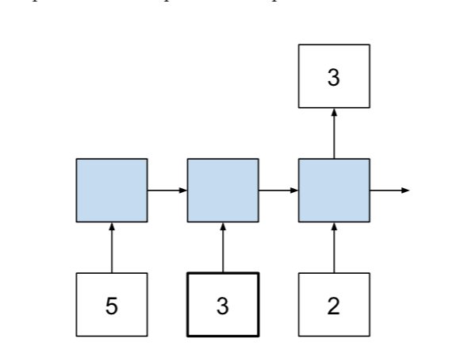
The Vanilla LSTM on Echo Sequence Prediction
Echo Sequence Prediction Problem
Given a sequence of random integers as input, to output the value of a random integer at a specific time input step that is not specified to the model.
For example, given the input sequence of random integers [5, 3, 2] and the chosen time step was the second value, then the expected output is 3.
Technically, this is a sequence classification problem; it is formulated as a many-to-one prediction problem, where there are multiple input time steps and one output time step at the end of the sequence.

Slide 5
The Stacked LSTM
The Stacked LSTM is a model that has multiple hidden LSTM layers where each layer contains multiple memory cells. We will refer to it as a Stacked LSTM here to differentiate it from the unstacked LSTM (Vanilla LSTM) and a variety of other extensions to the basic LSTM model.

Slide 6
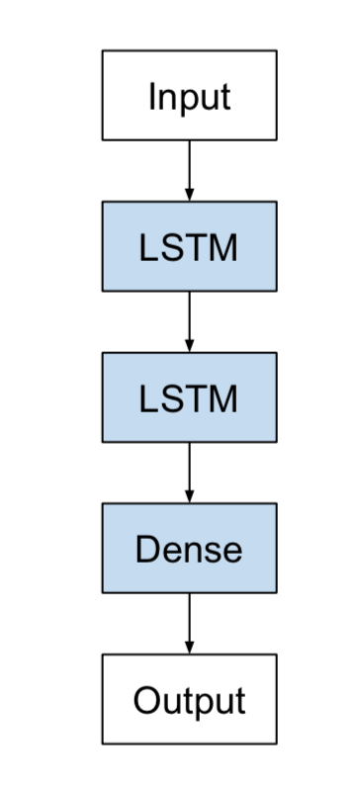
The Stacked LSTM
Why increase depth?
Stacking LSTM hidden layers makes the model deeper, more accurately earning the description as a deep learning technique. It is the depth of neural networks that is generally attributed to the success of the approach on a wide range of challenging prediction problems.
A Stacked LSTM architecture can be defined as an LSTM model comprised of multiple LSTM layers.

Slide 7
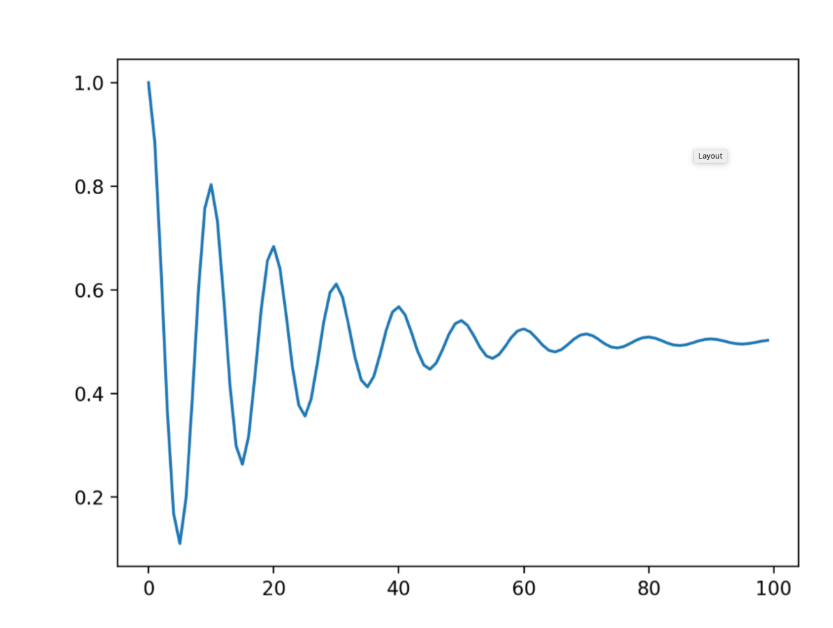
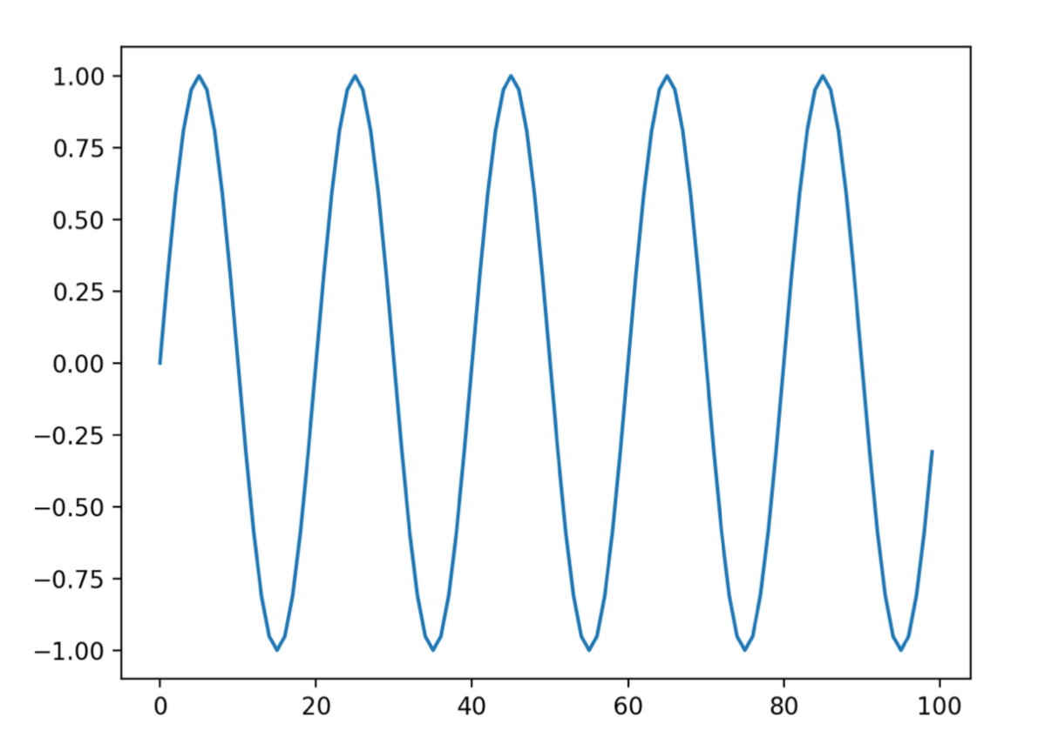
The Stacked LSTM on Damped Sine Waves
Damped sine wave is a type of sine wave that decreases with time.
Sine Wave
Damped Sine Wave

Slide 8
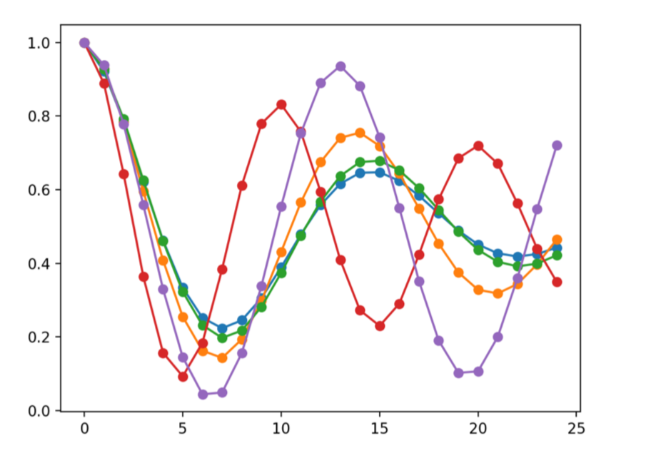
The Stacked LSTM on Damped Sine Waves
Running the example creates 5 damped sine wave sequences each with 20 time steps. An additional 5 time steps are generated at the end of the sequence that will be held back as test data.
Many-to-one Problem
Technically this is a many-to-one sequence prediction problem.
This may be confusing because we clearly intend to predict a sequence of output time steps.
The reason that this is a many-to-one prediction problem is because the model will not predict the output time steps piecewise; the whole prediction will be produced at once.

Slide 9
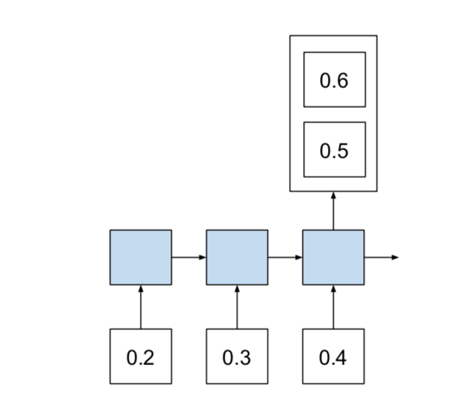
The Stacked LSTM on Damped Sine Waves
A sequence of n time steps is fed in, then at the end of the sequence a single prediction is made.
The prediction is a vector of n features that we will interpret as time steps.

Slide 10
The CNN LSTM
The CNN LSTM architecture involves using Convolutional Neural Network (CNN) layers for feature extraction on input data combined with LSTMs to support sequence prediction.
CNN LSTMs were developed for visual time series prediction problems and the application of generating textual descriptions from sequences of images (e.g. videos). Specifically, the problems of:
Activity Recognition: generating a textual description of an activity demonstrated in a sequence of images.
Image Description: generating a textual description of a single image.
Video Description: generating a textual description of a sequence of images.

Slide 11
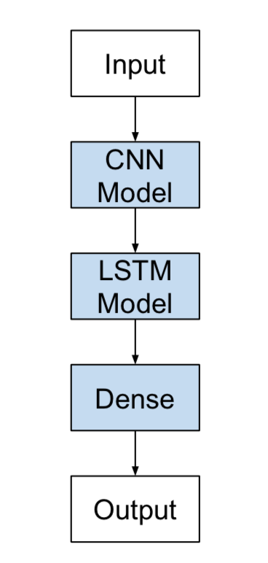
The CNN LSTM
This architecture is appropriate for problems that:
Have spatial structure in their input such as the 2D structure or pixels in an image or the 1D structure of words in a sentence, paragraph, or document.
Have a temporal structure in their input such as the order of images in a video or words in text, or require the generation of output with temporal structure such as words in a textual description.
It is helpful to think of this architecture as defining two sub-models: the CNN Model for feature extraction and the LSTM Model for interpreting the features across time steps.

Slide 12
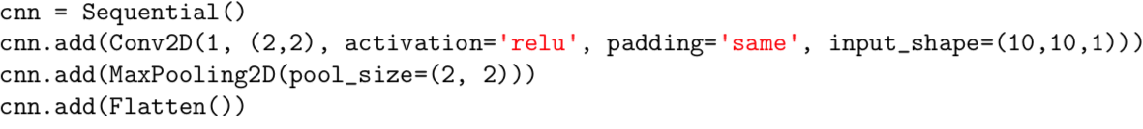
The CNN LSTM – CNN Model
Define a 2D convolutional network as comprised of Conv2D and MaxPooling2D layers ordered into a stack of the required depth.
The Conv2D will interpret snapshots of the image (e.g. small squares) and the pooling layers will consolidate or abstract the interpretation.
The Conv2D will read the image in 2 × 2 snapshots and output one new 10 × 10 interpretation of the image. The MaxPooling2D will pool the interpretation into 2 × 2 blocks reducing the output to a 5 × 5 consolidation. The Flatten layer will take the single 5 × 5 map and transform it into a 25-element vector ready for some other layer to deal with, such as a Dense for outputting a prediction.

Slide 13
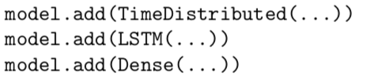
The CNN LSTM – LSTM Model
Conceptually there is a single CNN model and a sequence of LSTM models, one for each time step.
We want to apply the CNN model to each input image and pass on the output of each input image to the LSTM as a single time step.
We can achieve this by wrapping the entire CNN input model (one layer or more) in a TimeDistributed layer.
This layer achieves the desired outcome of applying the same layer or layers multiple times.
In this case, applying it multiple times to multiple input time steps and in turn providing a sequence of image interpretations or image features to the LSTM model to work on.

Slide 14
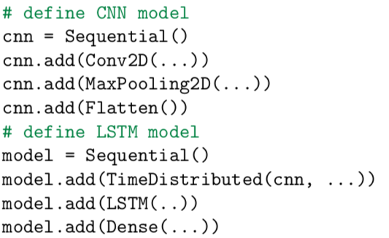
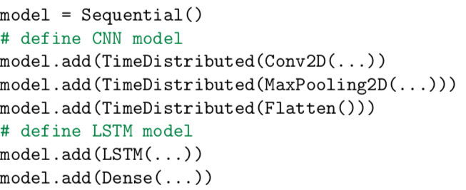
The CNN LSTM – CNN LSTM Model
Two ways to define the model:
Define the CNN model first, then add it to the LSTM model by wrapping the entire sequence of CNN layers in a TimeDistributed layer:
Wrap each layer in the CNN model in a TimeDistributed layer when adding it to the main model.

Slide 15
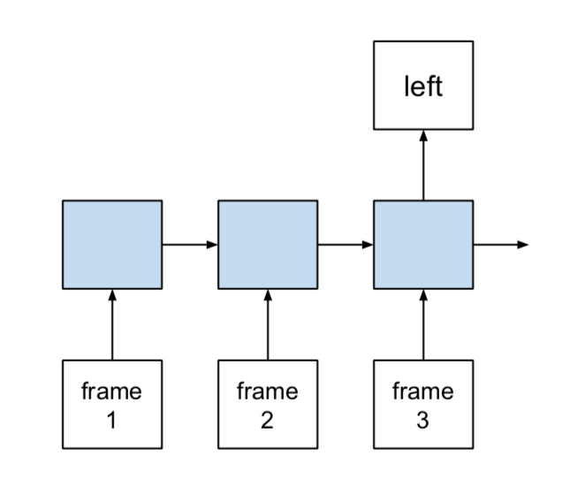
The CNN LSTM – Moving Square Video Prediction Problem
The problem involves the generation of a sequence of frames.
In each image a line is drawn from left to right or right to left. Each frame shows the extension of the line by one pixel.
The task is for the model to classify whether the line moved left or right in the sequence of frames.
Technically, the problem is a sequence classification problem framed with a many-to-one prediction model.

Slide 16
The CMM LSTM – CNN Input Data Prepare
The input sequences for the model must be resized to be suitable for a 2D CNN:
[width, height, channels]
In our case, it would be [size, size, 1] for the symmetrical black and white images.
The multiple images, then multiple sequences of images. Therefore, the input to the model must be reshaped as:
[samples, timesteps, width, height, channels]
In our case will be:
[n_patterns, size, size, size, 1]

Slide 17
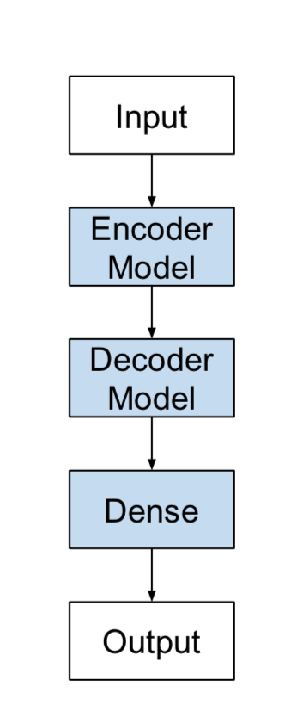
Encoder-Decoder LSTMs
Sequence-to-Sequence Prediction Problems (seq2seq)
Takes a sequence as input and requires a sequence prediction as output.
One approach to seq2seq prediction problems that has proven very effective is called the Encoder- Decoder LSTM.
Encoder-Decoder LSTM
It was developed for natural language processing problems where it demonstrated state-of-the-art performance, specifically in the area of text translation called statistical machine translation. The innovation of this architecture is the use of a fixed-sized internal representation in the heart of the model that input sequences are read to and output sequences are read from.

Slide 18

Encoder-Decoder LSTMs – Addition Prediction Problem
The problem is defined as calculating the sum output of two input numbers.
Each digit and mathematical symbol is provided as a character and the expected output is also expected as characters. For example, the input 10+6 with the output 16 would be represented by the sequences:
The model must lean not only the integer nature of the characters, but also the nature of the mathematical operation to perform.
Notice how sequence is now important, and that randomly shuffling the input will create a nonsense sequence that could not be related to the output sequence.
Also notice how the number of digits could vary in both the input and output sequences.
Technically this makes the addition prediction problem a sequence-to-sequence problem that requires a many-to-many model to address.

Slide 19
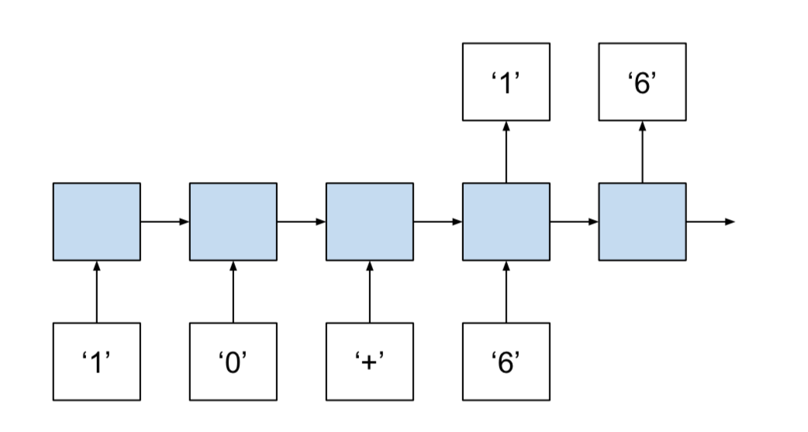
Encoder-Decoder LSTMs – Addition Prediction Problem
This problem can be implemented in Python.
We will divide this into the following steps:
Generate Sum Pairs.
Integers to Padded Strings.
Integer Encoded Sequences.
One Hot Encoded Sequences.
Sequence Generation Pipeline.
Decode Sequences.

Slide 20
Generative LSTMs
LSTMs can be used as a generative model. Given a large corpus of sequence data, such as text documents, LSTM models can be designed to learn the general structural properties of the corpus, and when given a seed input, can generate new sequences that are representative of the original corpus.
The approach has also been applied to different domains where a large corpus of existing sequence information is available and new sequences can be generated one step at a time, such as:
Handwriting generation.
Music generation.
Speech generation.

Slide 21
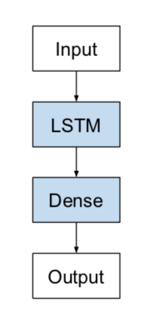
Generative LSTMs
A Generative LSTM is not really architecture, it is more a change in perspective about what an LSTM predictive model learns and how the model is used. We could conceivably use any LSTM architecture as a generative model. In this case, we will use a simple Vanilla LSTM.
Example – Generate Random Rectangles – Generative LSTMs

